Slide 1
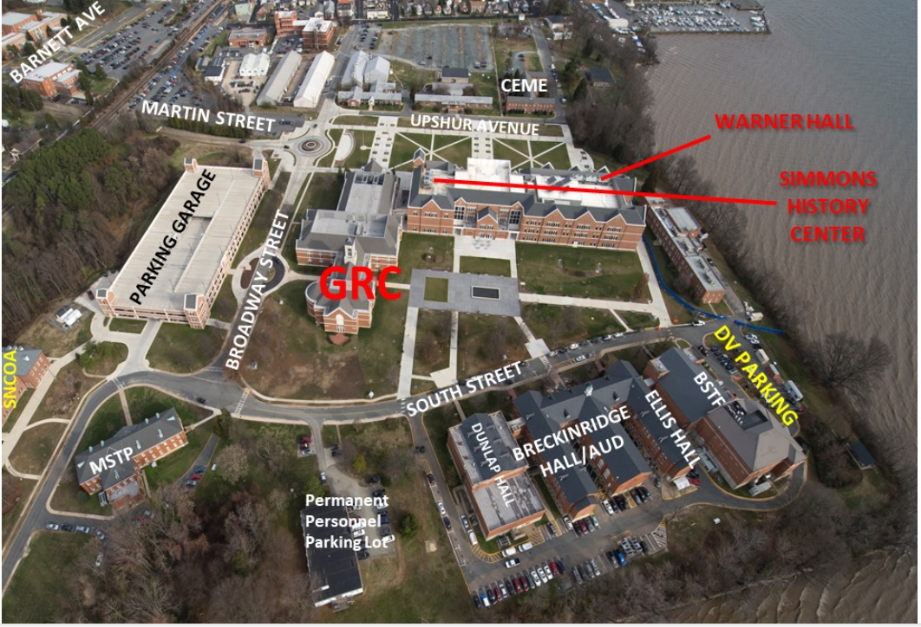

Slide 2
Directions to MCU
Take Interstate 95 to exit 150 (East towards Triangle/Quantico)
Upon exiting from ramp, continue straight to the traffic light at Route 1.
Cross over Route 1, continuing straight. A small replica of the flag raising at Iwo Jima will be on your right after you pass through the intersection.
Travel under the archway to the main gate. The speed limit through the gate is 15 mph.
Proceed through the gate and remain on Fuller Road for approximately 2 miles. You will pass through the golf course.
Continue around the bend and down the hill until you pass Little Hall.
Just before the fire station, turn left onto Martin Street.
Go through the tunnel and make a right. Parking is immediately on your right and the university is in the building facing the water in front of you.
Marine Corps University 2076 South Street Quantico, VA 22134

