Slide 1
STEP-BY-STEP GUIDE TO COMPLETE PASSPORT APPLICATION
MARINE CORPS EMBASSY SECURITY GROUP HEADQUATERS COMPANY
GO TO
HTTPS://PPTFORM.STATE.GOV

Slide 2
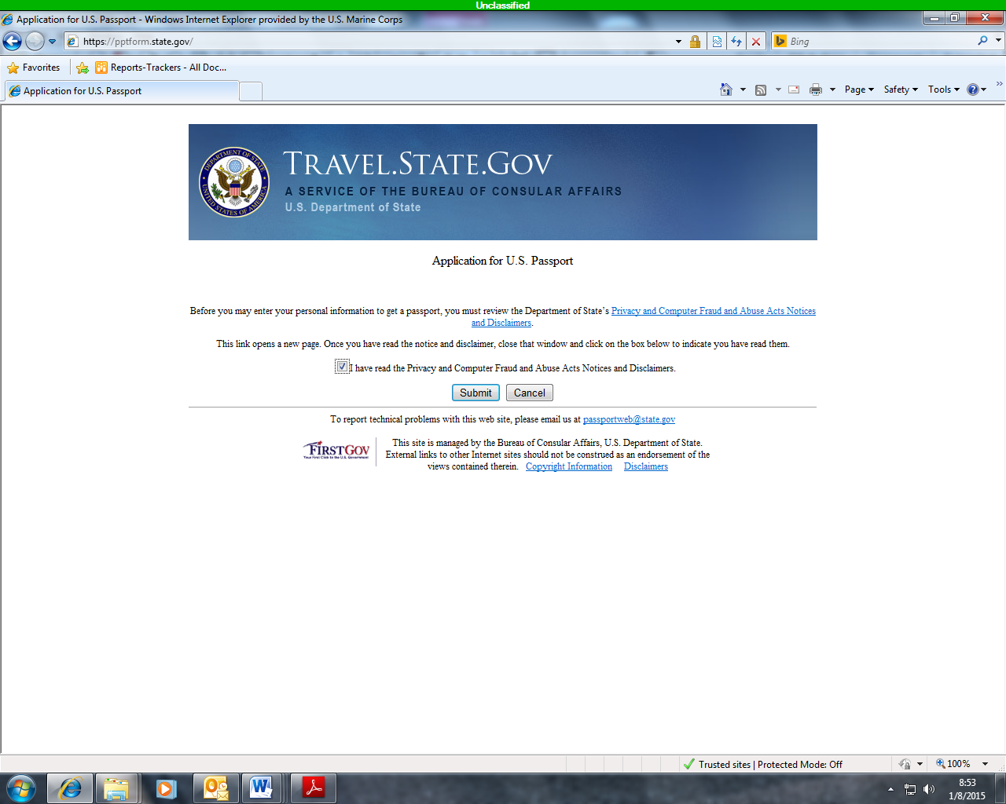
CHECK BOX
CLICK SUBMIT
CHECK THE BOX
CLICK SUBMIT

Slide 3
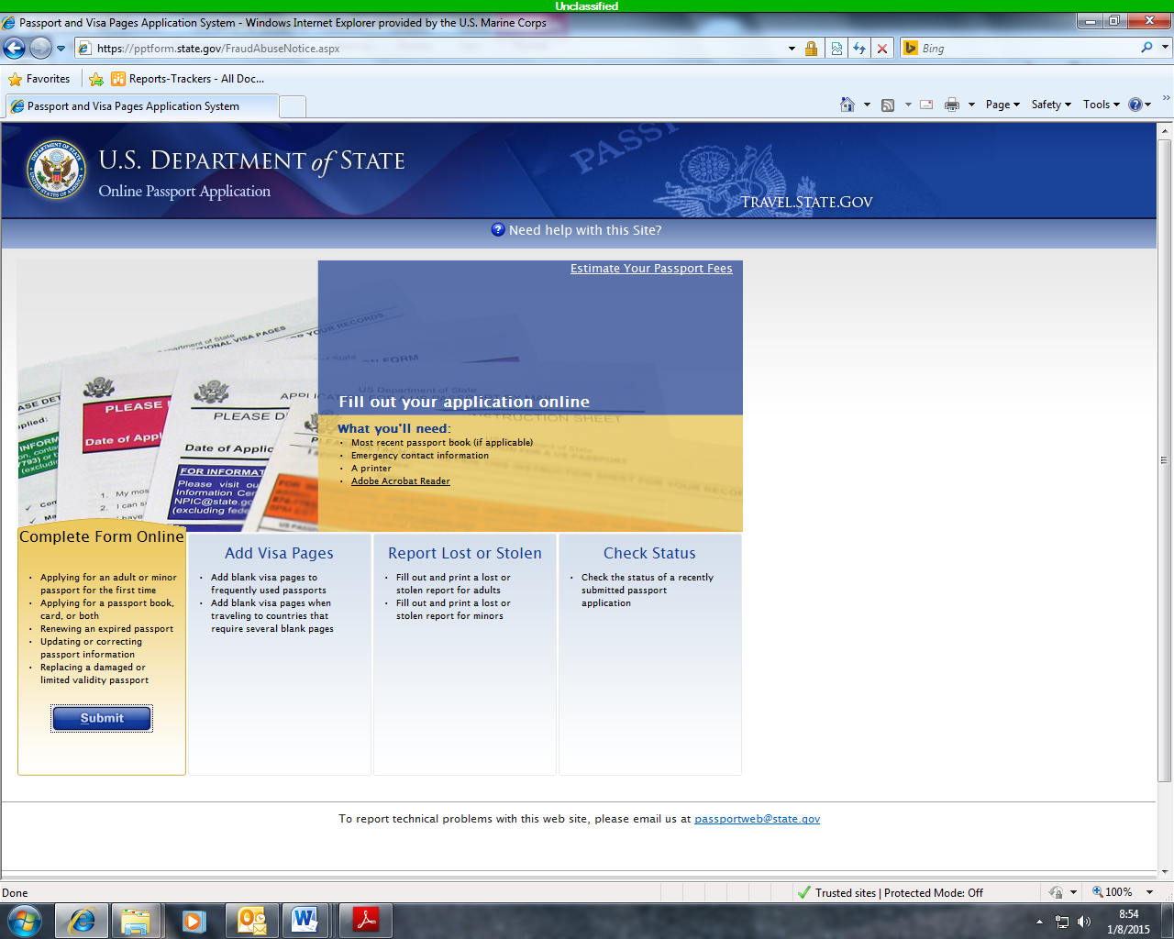
CLICK SUBMIT

Slide 4
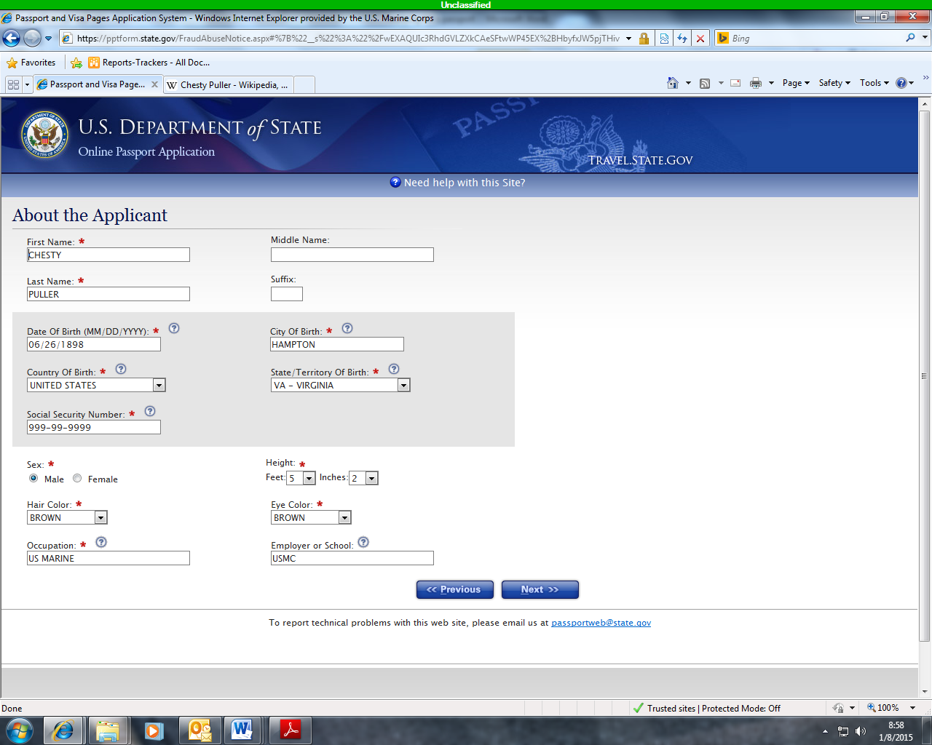
INDICATES REQUIRED INFORMATION
CLICK NEXT

Slide 5
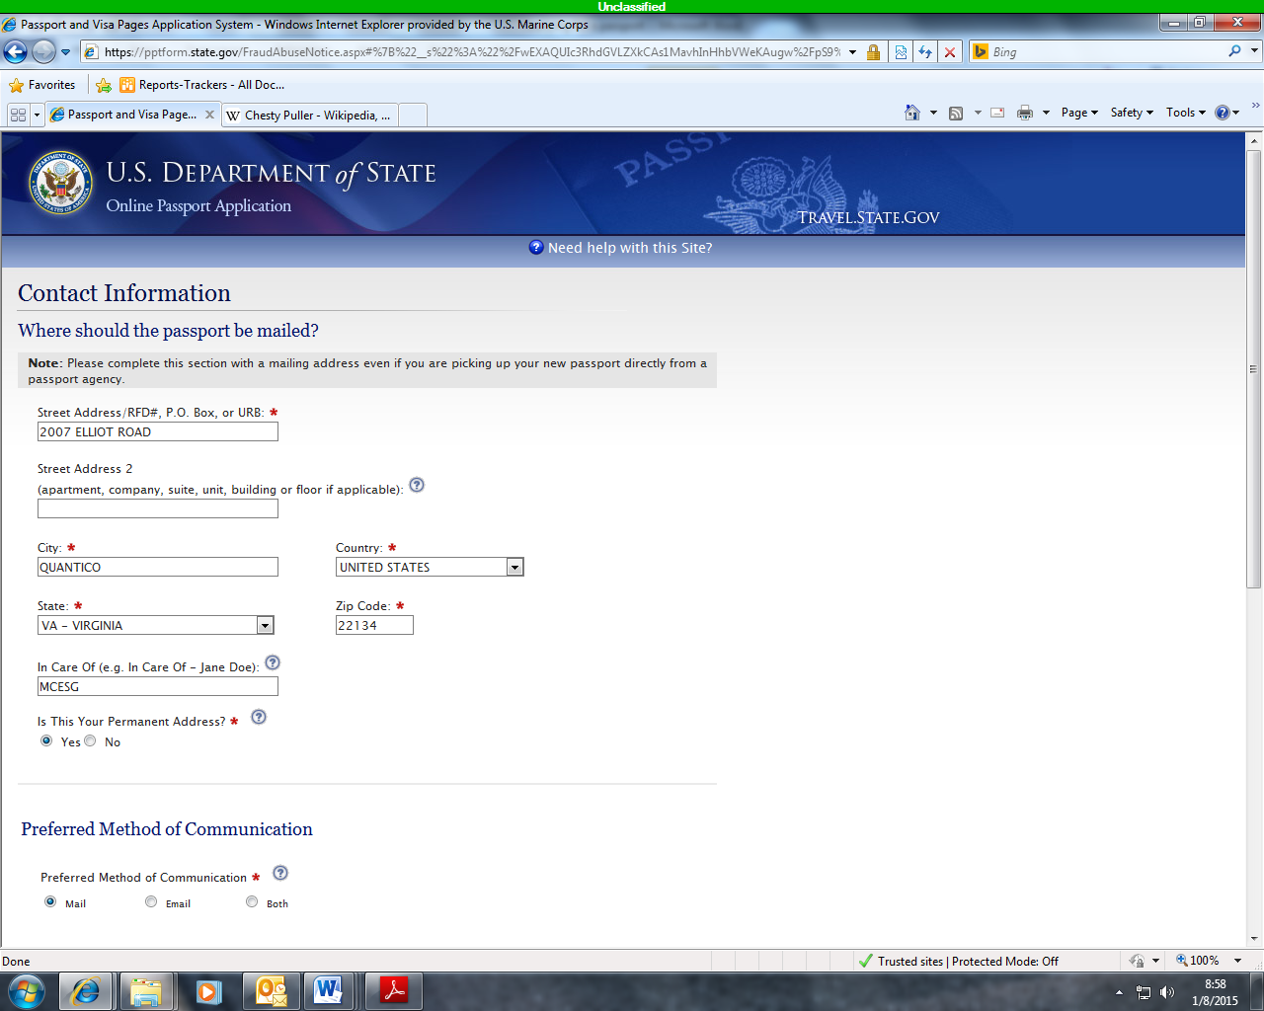
TYPE INFORMATION AS SEEN ON THIS PAGE
SCROLL DOWN
CLICK NEXT

Slide 6
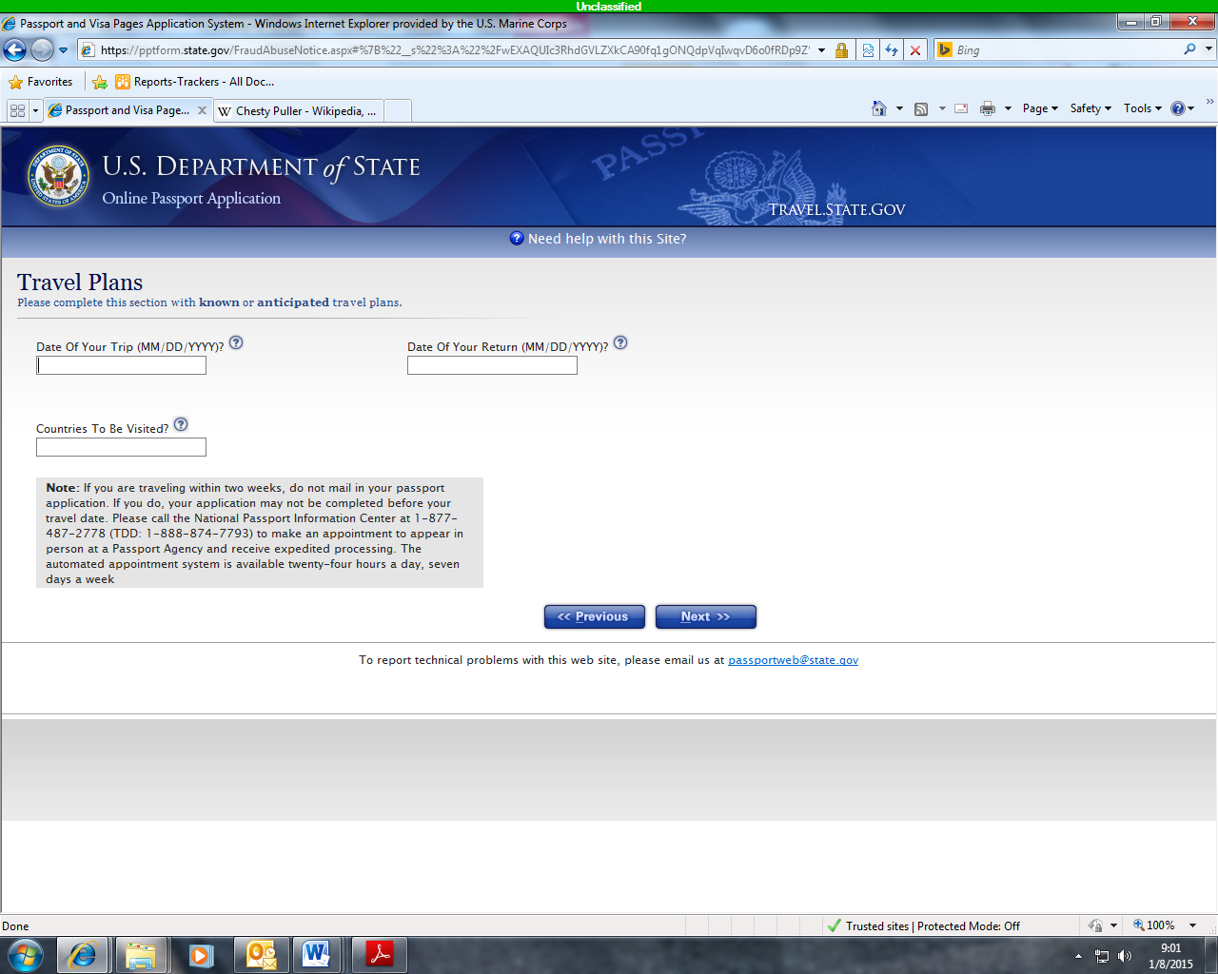
LEAVE THIS PAGE BLANK
CLICK NEXT

Slide 7
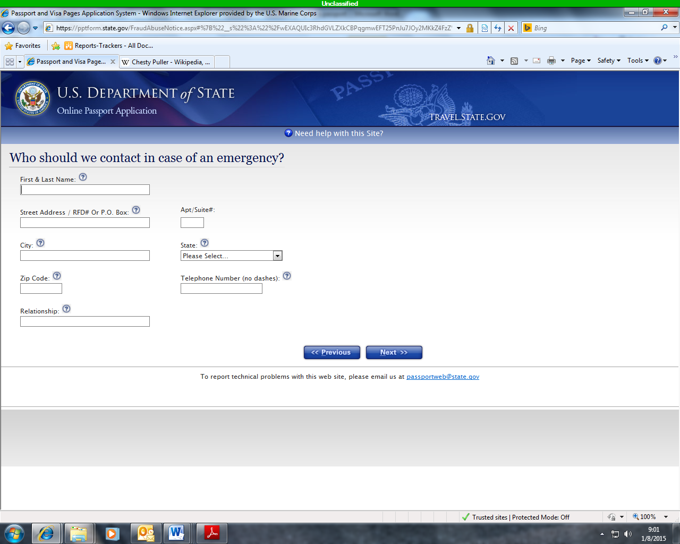
LEAVE THIS PAGE BLANK
CLICK NEXT

Slide 8
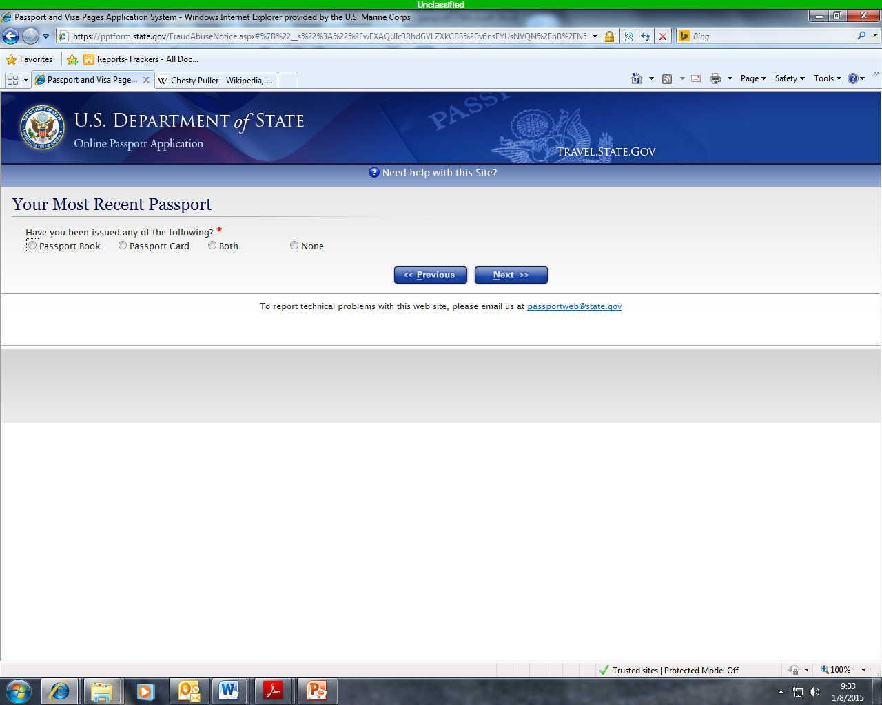
CLICK NEXT
ONLY IF YOU HAVE A PASSPORT SELECT PASSPORT BOOK,
IF NOT,
SELECT NONE

Slide 9
IF YOU SELECTED NONE,
CONTINUE ON TO SLIDES 19-26 TO COMPLETE THE APPLICATION PROCESS

Slide 10
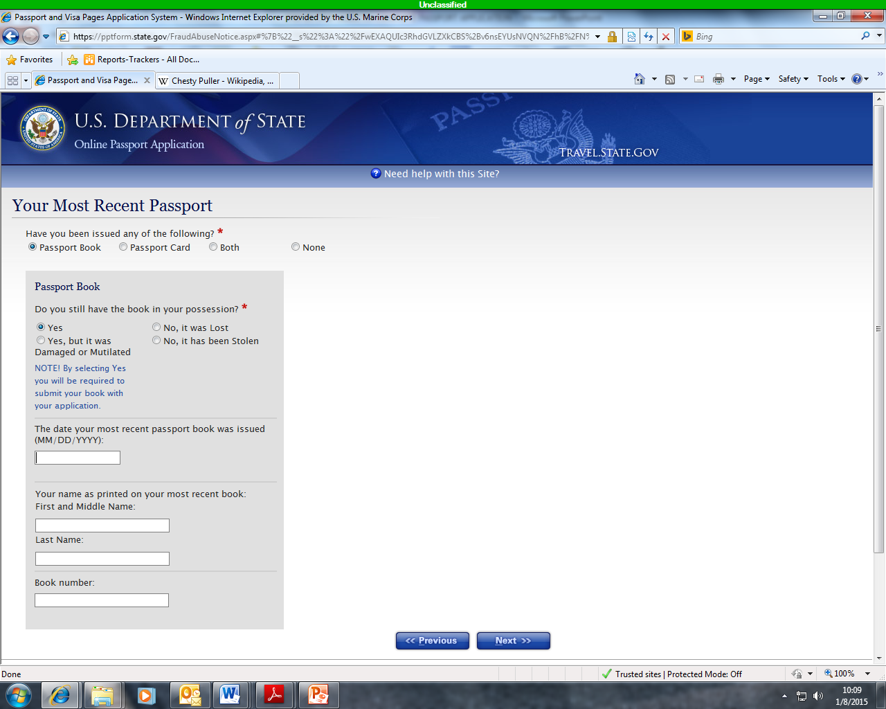
**FILL FORM IF YOU HAVE A PASSPORT**
CLICK NEXT

Slide 11
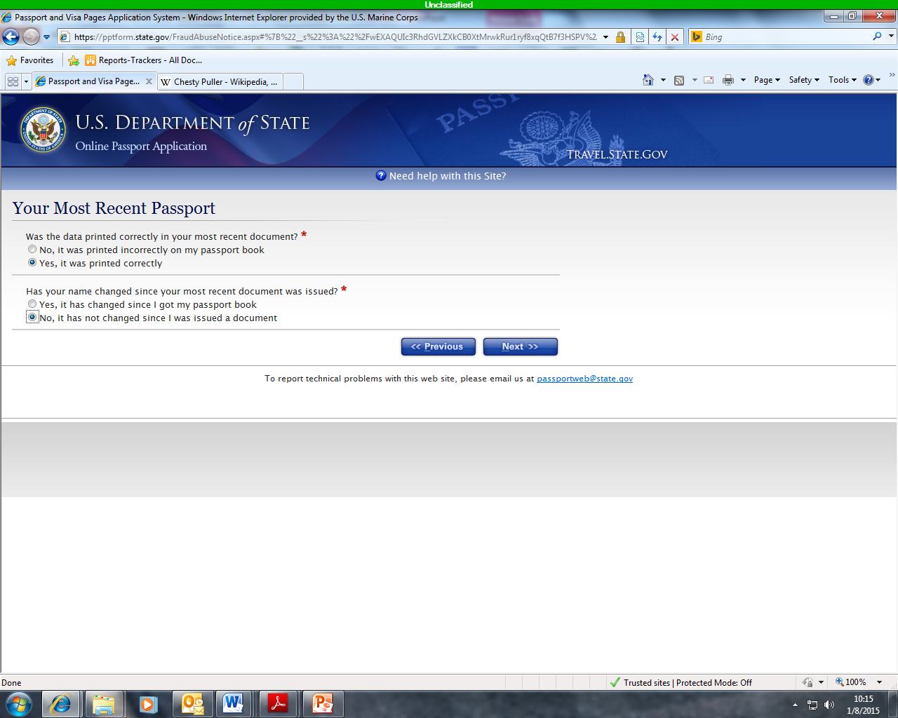
CLICK NEXT
SELECT

Slide 12
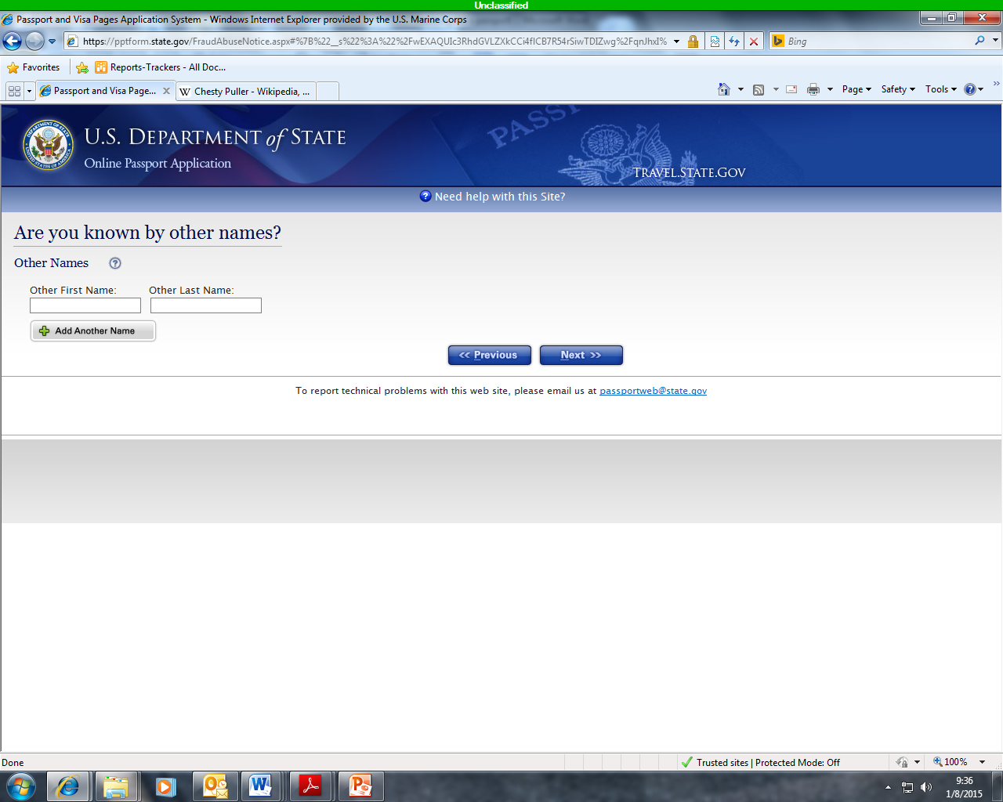
CLICK NEXT
INSERT LEGAL NAME CHANGE
**ENSUREYOU HAVE DOCUMENTATION**

Slide 13
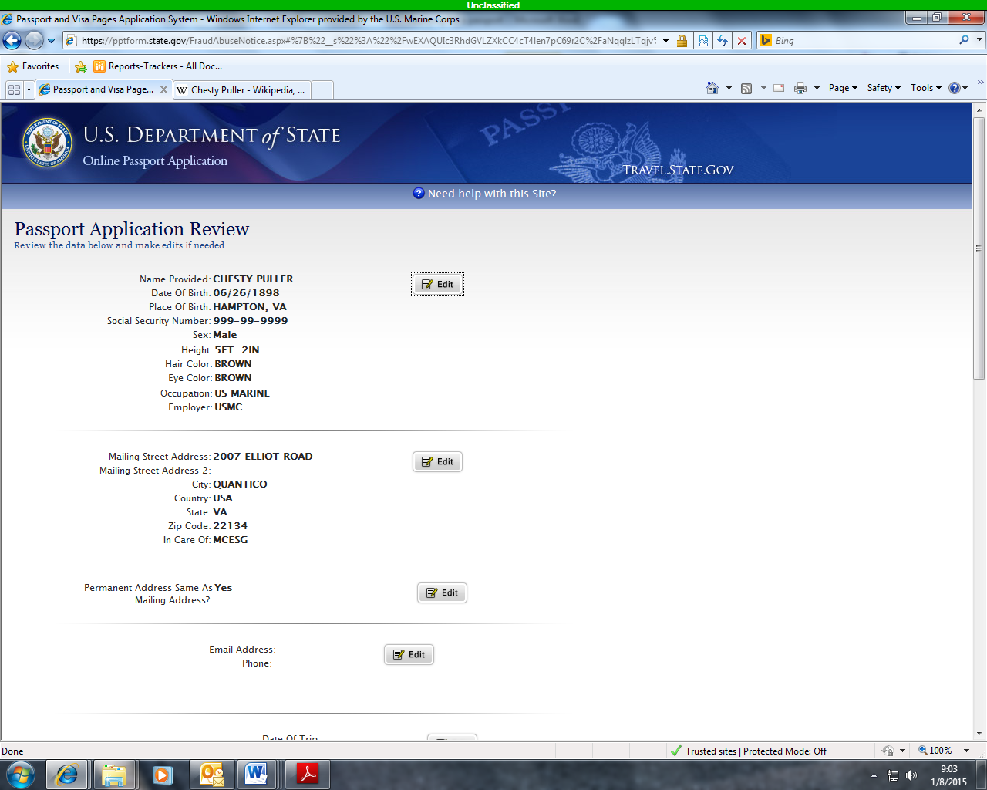
REVIEW AND
MAKE CORRECTIONS IF NEEDED
SCROLL DOWN
CLICK NEXT

Slide 14
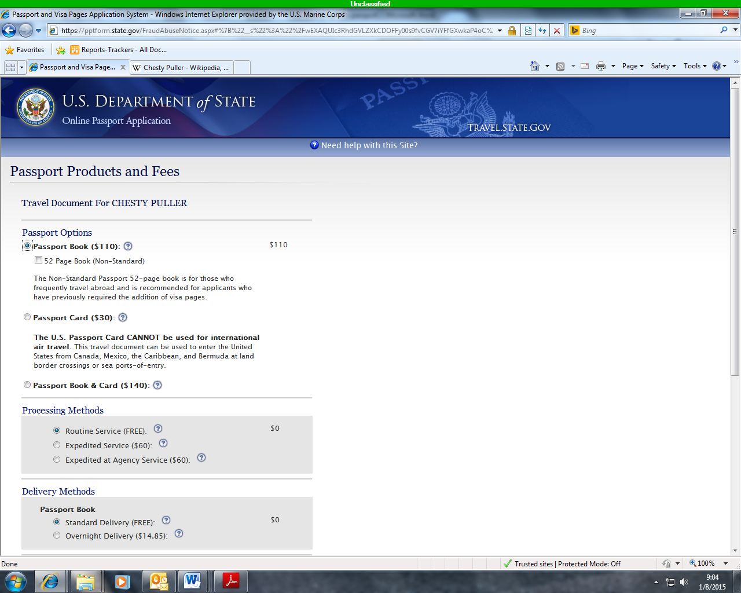
SELECT PASSPORT BOOK
SCROLL DOWN
CLICK NEXT

Slide 15
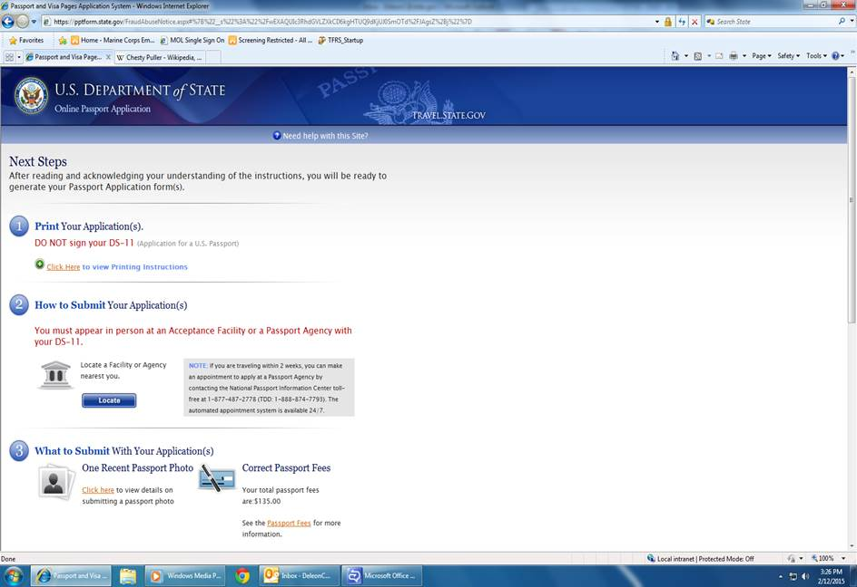
DO NOT SIGN YOUR APPLICATION
SCROLL DOWN

Slide 16
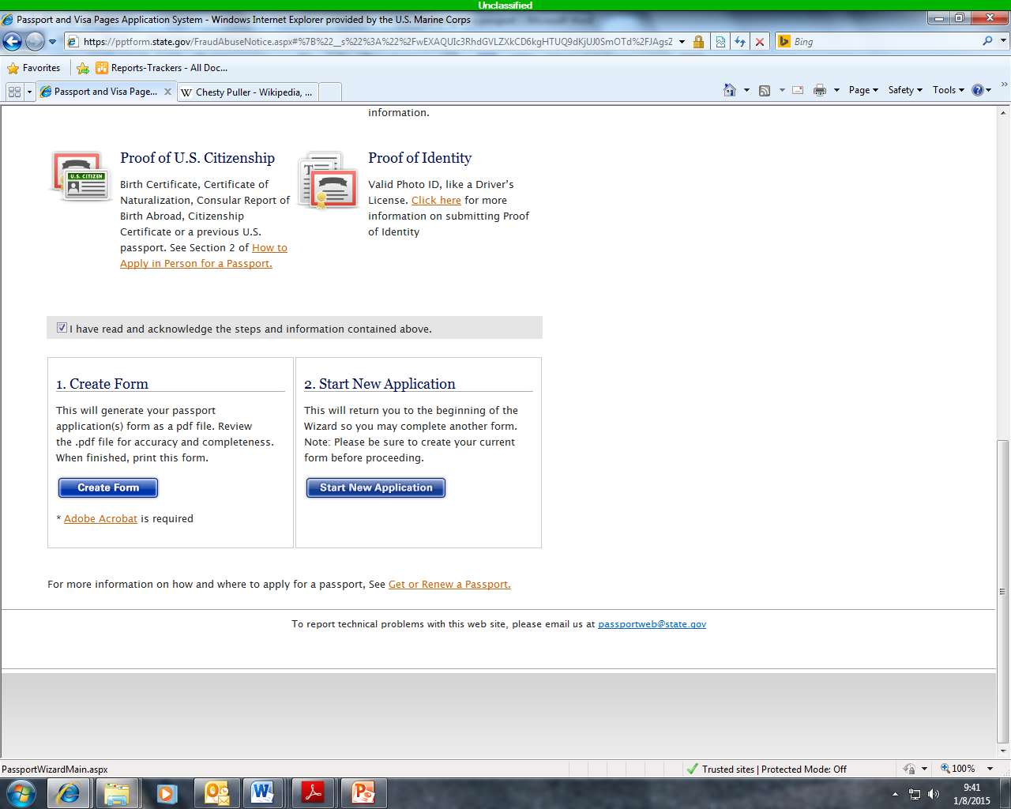
SELECT TO ACKNOWLEGE
SELECT CREATE FORM

Slide 17
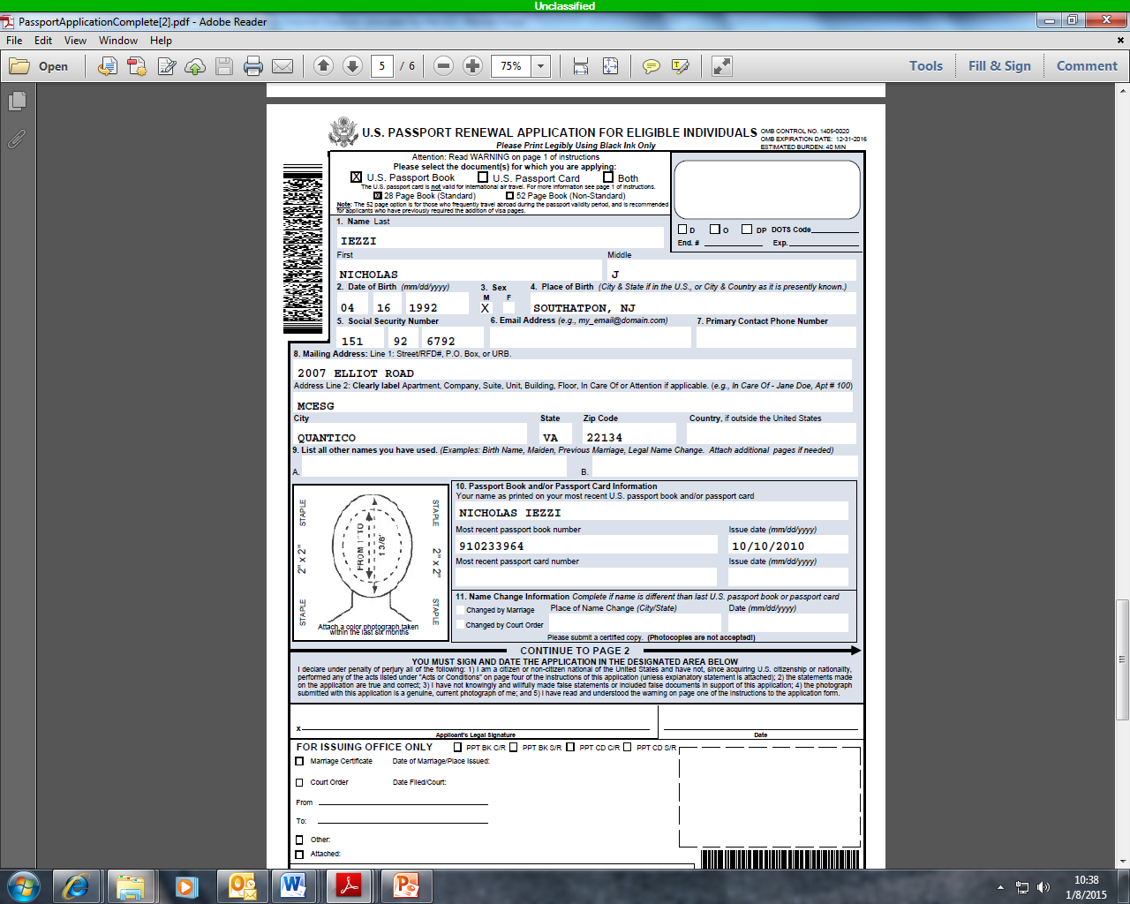
FORM FOR PASSPORT HOLDERS
SAMPLE

Slide 18
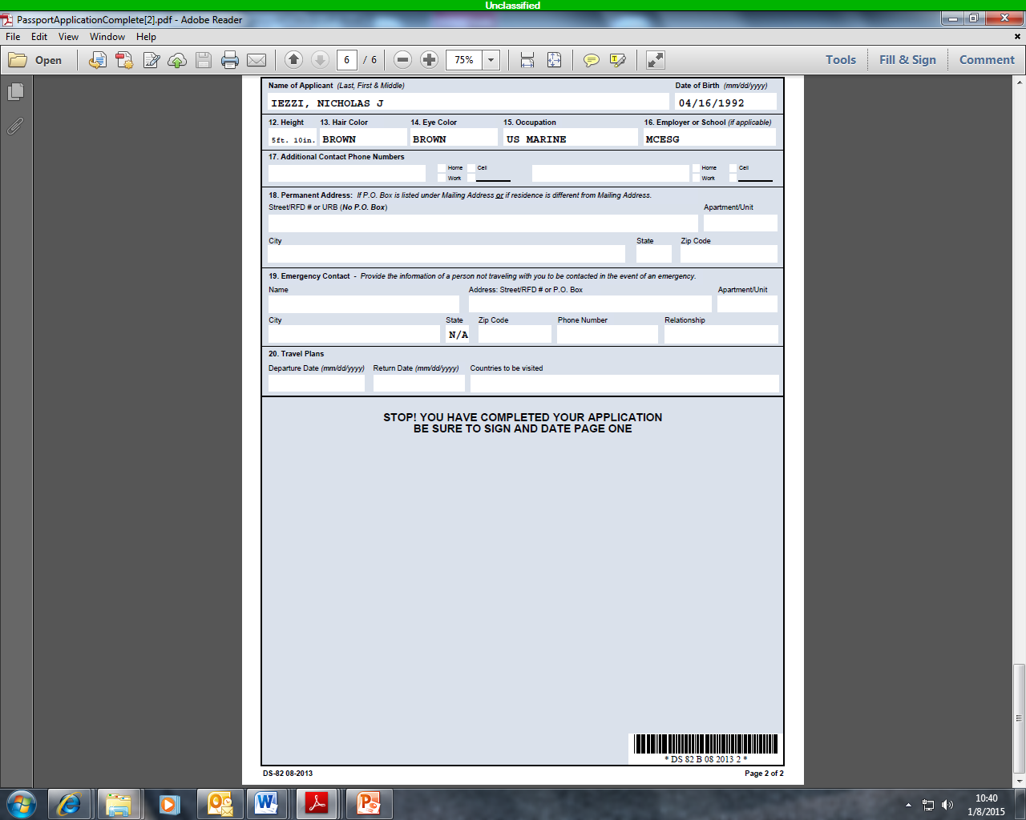
SAMPLE

Slide 19
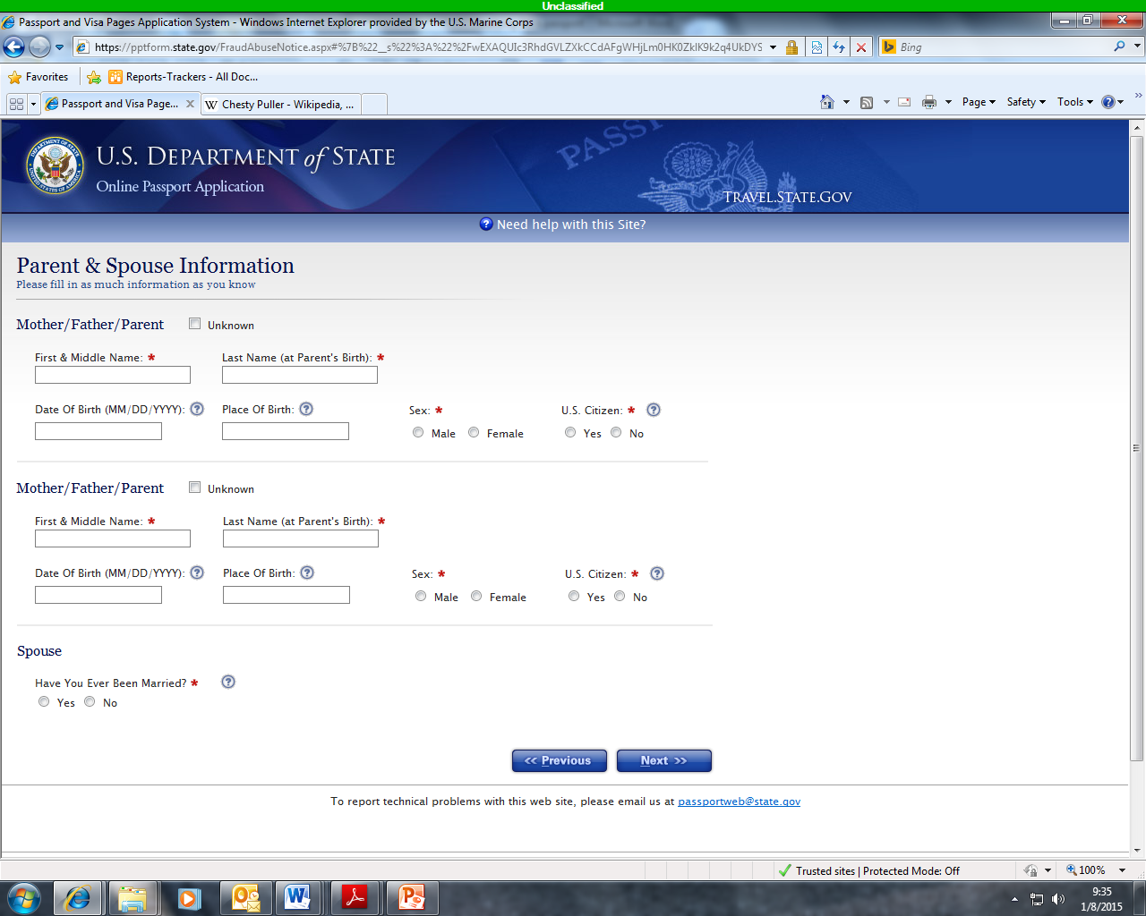
CLICK NEXT

Slide 20
CLICK NEXT
INSERT LEGAL NAME CHANGE
**ENSUREYOU HAVE DOCUMENTATION**

Slide 21
REVIEW AND
MAKE CORRECTIONS IF NEEDED
SCROLL DOWN
CLICK NEXT

Slide 22
SELECT PASSPORT BOOK
SCROLL DOWN
CLICK NEXT

Slide 23
DO NOT SIGN YOUR APPLICATION
SCROLL DOWN

Slide 24
SELECT TO ACKNOWLEGE
SELECT CREATE FORM

Slide 25
FOR NEW PASSPORT APPLICATION THE DS-11 FORM WILL LOOK LIKE THE NEXT SLIDE.

Slide 26
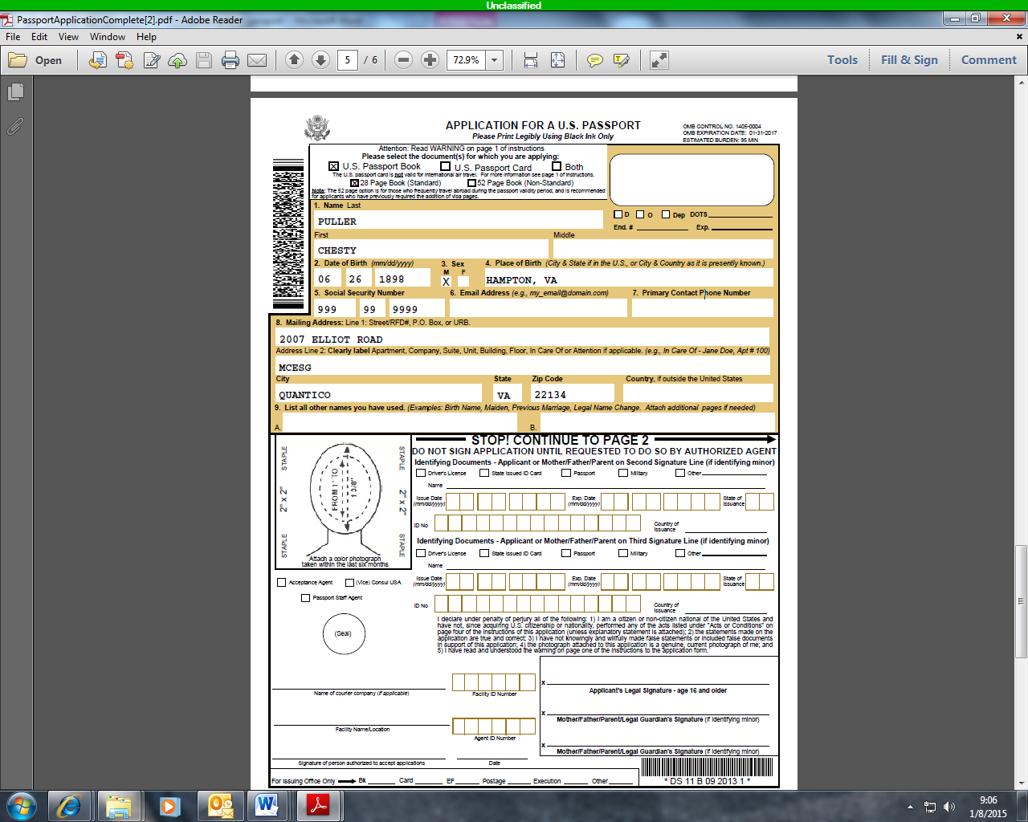
FORM FOR NON-PASSPORT HOLDERS
SAMPLE

Slide 27
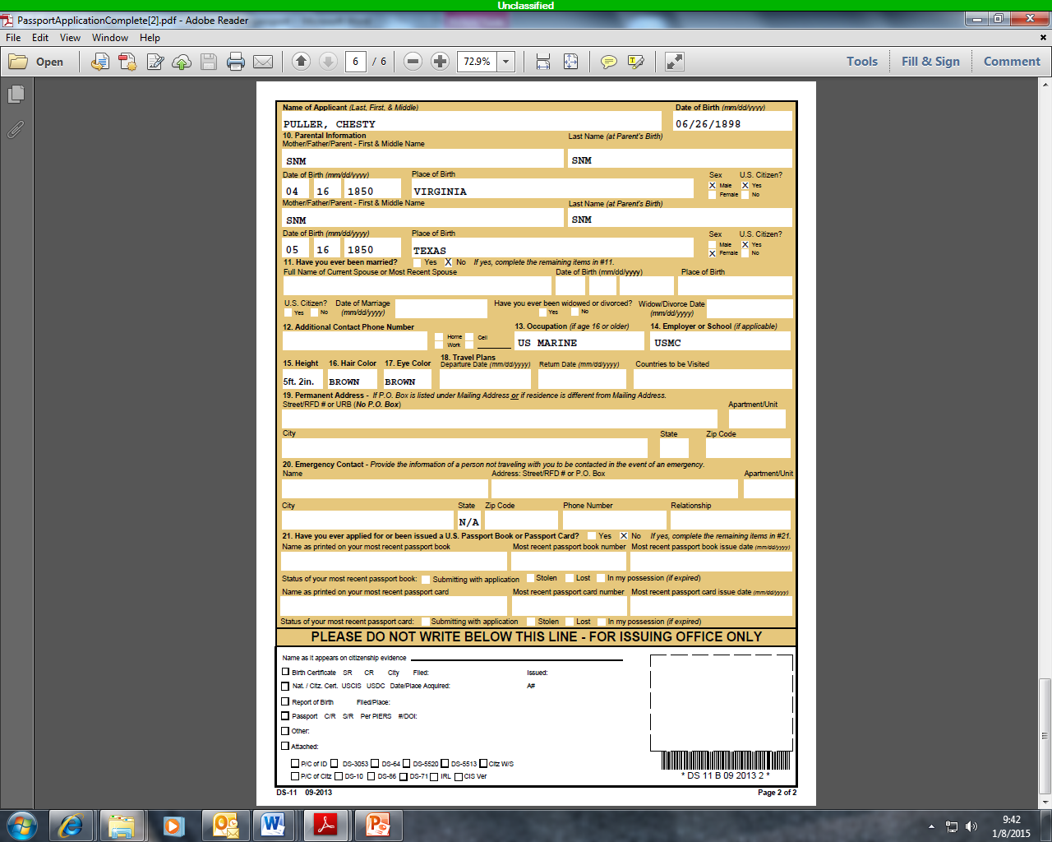
SAMPLE

